Slide 2
Can We Predict Stocks?
Stocks generally follow Efficient Market Hypothesis (EMH)
Stock price considers all available info and stocks only respond to new info
This makes stocks unpredictable → random walk
Stock prediction accuracy ~50% and not exceed it (fair trading metric)
Short term & seasonal trends “can” contradict EMH
Momentum : Stocks that have recently been increasing continue to increase for few days; same applies for decreasing stocks
Adds predictability to the stock price over short term
Long-term price trend follows seasonal variation : holidays quarters rock for retail / electronics
Aim of the project is short term prediction based on price index movement for past 6 months; with accuracy ~ 70%

Slide 3
Overview of Training Model For Each Trade
X_{train/test}
Y_{train}
Price Data
Feature Generation
Feature Selection
Training Labels
6-month data from Yahoo finance
10 features calculated from price trend
Down select key features
Decision Labels
Y(t) = fn (future price trend)
Raw Data
Attributes = fn (time)
Date
Momentum (MOM)
Rank the features
Very Bullish (1)
Open/Close
Rate of change (ROCR)
Bullish (2)
Extreme Randomized Tree Algorithm
Volume
Relative Strength (RSI)
Neutral (3)
High/Low
Bearish (4)
Moving Average (MACD)
Top 50% features retained
Very Bearish (5)

Slide 4
Feature Generation
I. Trend Indicators II. Change Indicators III. Mixed(Trends + Change) IV. Volatility Indicators

Slide 5
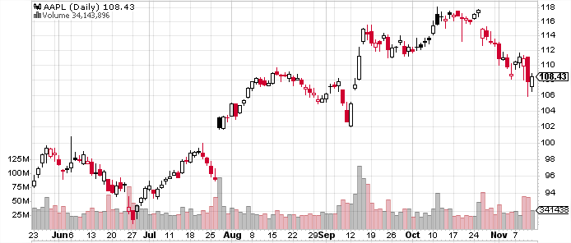
Feature Extraction:
Price Value
Volume
6 month data
Raw data: Open / Close each day ; Volume; intraday highs & lows
Processed data : Candlestick plot shows price “change” trend – red box → loss; open box → gain
: Simple construction of Y_{train} = -1 if next day is red box; 1 if open box

Slide 6
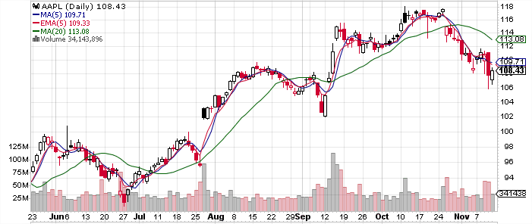
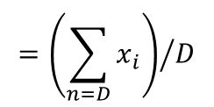

Features : Trends
$X_{i}=\{$SMA3, EMA3, EMA6, TRIX$\}$
SMA5
EMA5
SMA50
$$={\left(\sum_{n=D}{x_{i}}\right)}/D$$
SMAD : Simple Moving Average For ‘D’ days
EMAD : Exponential Moving Average For ‘D’ days
TRIX : Triple EMA is TR(t)/TR(t-1) where TR(t) = EMA(EMA(EMA(Price(t)))

Slide 7
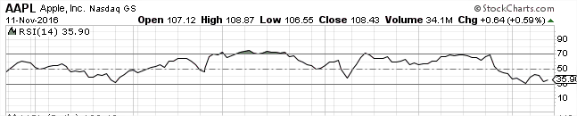

Features : Changes
$X_{i}=\{$ROCR3, ROCR12, MOM1, MOM3, WILLR, RSI6, RS112$\}$
ROCR : Rate of Change = (Price(t)/Price(t-n))*100
MOM : Momentum = Price(t) - Price(t-n)
WILLR: Williams %R = (High-Closed)/ (High-Closed)*100
RSI : Relative Strength = (High-Closed)/ (High-Closed)*100
$=100−\frac{100}{1+RS}$ where $RS=\frac{Avg. Losses}{Avg.gains}$
Extremely popular indicator
RSI

Slide 8
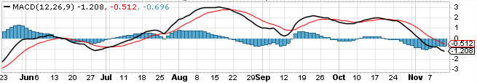

Features : Trends + Changes
$X_{i}=\{$MACD, MACDSig, MACDHist$\}$
MACD line
Series line
MACD(a,b,c) : Moving Average Convergence Divergence
MACD Series = (EMA for a days – EMA for b days)
Signal Line = Calculate EMA of MACD series for c days
Histogram = MACD Series – Signal Line
Extensively Used Metric For Traders :
MACD Line: (12-day EMA - 26-day EMA)
Signal Line: 9-day EMA of MACD Line

Slide 9


Features : Volatility
Average true range (ATR):
High ATR → Traders are enthusiastic & committed to the stock
Low ATR → Interest is waning

Slide 10
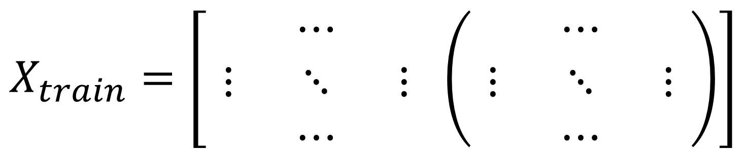
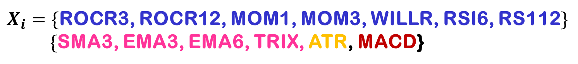
Summary of Features Extracted:
$X_{i}=\{$ROCR3, ROCR12, MOM1, MOM3, WILLR, RSI6, RS112$\}$
$\{$SMA3, EMA3, EMA6, TRIX, ATR, MACD}
Xi (t) for the stock
Xi (t) for the S&P500
$$X_{train}=\left[\begin{matrix} & ⋯ & \\ ⋮ & ⋱ & ⋮ \\ & ⋯ & \end{matrix} \left(\begin{matrix} & ⋯ & \\ ⋮ & ⋱ & ⋮ \\ & ⋯ & \end{matrix}\right)\right]$$
We also analyze S&P 500 and add to X_{train}

Slide 11
Ranking Features:

Slide 12
Training Model

Slide 13
How To Create Training Labels Y

Slide 14
Testing The Model Using SVM

Slide 15
Dependence of Accuracy With N_Features

Slide 16
How Well In Future is Model Accurate?

Slide 17
Conclusion & Future Work

Slide 18
